Slide 1

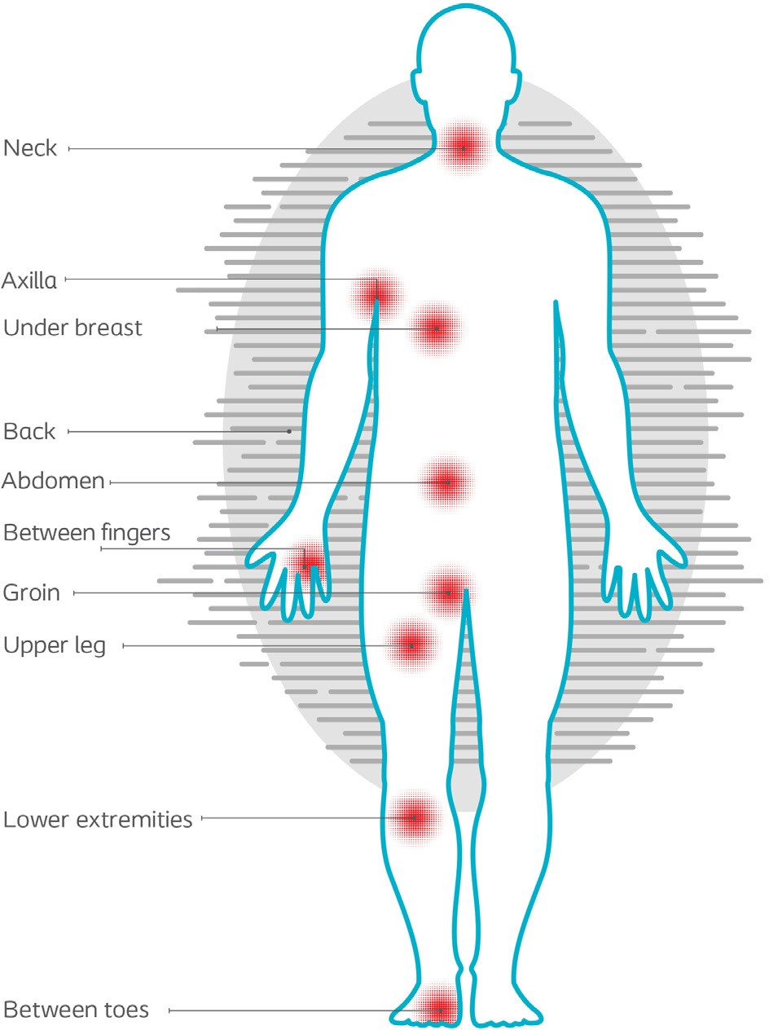

Insert title (include diagnosis)
Author: Name, job title, place of employment
Patient
Include appropriate information about the patient, such as:
Age, gender, social status, medical history, weight and BMI Include appropriate information about the skin affected, such as: Type of problem
Location of affected area(s) – mark location(s) on Figure 1
Duration of skin problem
Previous treatments including e.g. cost and duration.
Figure 1
Pain experienced:
Mark level of pain on the numeric pain rating scale below:
0-10 Numeric Pain Rating Scale
0 1 2 3 4 5 6 7 8 9 10
No pain
Moderate Worst
pain possible
pain
Initial skin assessment
Insert photo from initial assessment (day 1)
Note what is observed on assessment of the skin, such as:
Erythema | Clear of redness | Slight pink
 | Moderate redness | Servere (“Fire engine red”)
Maceration | Yes No
Itching/burning | Yes No
Denudement | Yes No
Satellite lesions | Yes No
Odour | No unpleasant smell | Minimal (barely noticeable)
 | Strong (intolerable) | Moderate (noticeable, but tolerable)
•
•
•
•
•
•
•
•
•
•
•
•
•
•
•
•
Other - please specify

Slide 2


Treatment goals
Write the treatment goals for the patient, based on what was observed on assessment e.g. manage maceration. Remember to include treatment goals that will address the findings from the assessment, and make a link between these steps.
Treatment
Write about the treatment of this patient. Remember to include all treatment needed to address all the management goals (e.g. removal of irritants from the skin). Consider to include information about the usability/application/fixation of InterDry® if relevant. Include how InterDry® for management of affected area(s) will have an effect on addressing the management goals.
Results
Describe what happened to the skin based on the treatment given. Remember to mention what happened on all the parameters where there was a positive finding on initial assessment.

Slide 3

Erythema
•
Clear of redness
•
Slight pink
•
Moderate redness
•
Servere (“Fire engine red”)
•
Maceration | Clear of maceration | Much better | Better | Same | Worse | Much worse
Itching/burning | Clear of iItching/burning | Much better | Better | Same | Worse | Much worse
Denudement | Clear of denudement | Much better | Better | Same | Worse | Much worse
Satellite lesions | Clear of satellite lesions | Much better | Better | Same | Worse | Much worse
•
•
•
•
•
•
•
•
•
•
•
•
•
•
•
•
•
•
No unpleasant smell
•
•
•
•
•
Odour
•
•
Minimal (barely noticeable)
•
Strong (intolerable)
•
Moderate (noticeable, but tolerable)
Other - please specify
Also note significant changes to patient related issues. e.g. ease of application, did the product stay in place, how many pieces of fabric was used over the length of the treatment period, how long was the treatment period, how many times within 5 days’ of treatment was it necessary to change the piece of fabric etc.
XX Days after initial assessment
XX Days after initial assessment
Insert photo from assessment and note day after initial assessment
Insert photo from assessment and note day after initial assessment
Conclusion
Include what features and benefits of the product have allowed it to manage the skin problem, and if InterDry could replace previous treatment and what this would mean to the physician and patient. for the physician and patient will be.
.
I hereby consent that Coloplast may freely use the information and photos in the case report. Please double click on PDF icon to learn more →

